Slide 1
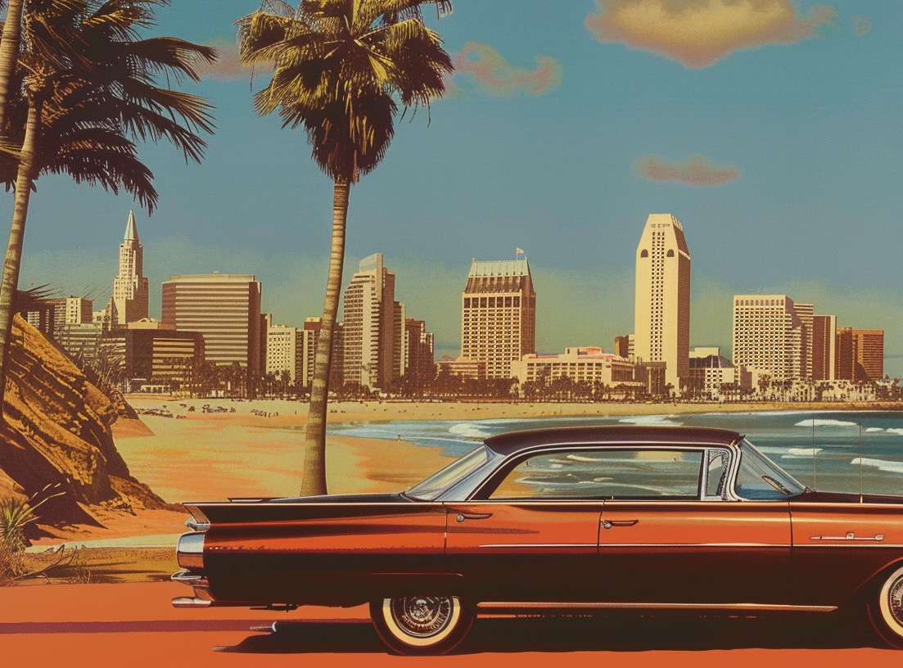
State Libraries and AI Technologies (SLAAIT)
Update and Planning
June 29, 2024

Slide 2
Agenda
Welcome
Work in Progress
  Increased communication
    The Full SLAAIT weekly newsletter | Field Notes: Summary of Interviews with SLAAIT members
  SLAAIT Member Interviews: What We Learned
    Trends | What SLAAIT members want
  Upcoming Seminars
  Technology Petting Zoo
  AI Competencies
Presentation: AI and Book Banning
Public AI Infrastructure Project
General Discussion
Adjourn

Slide 3
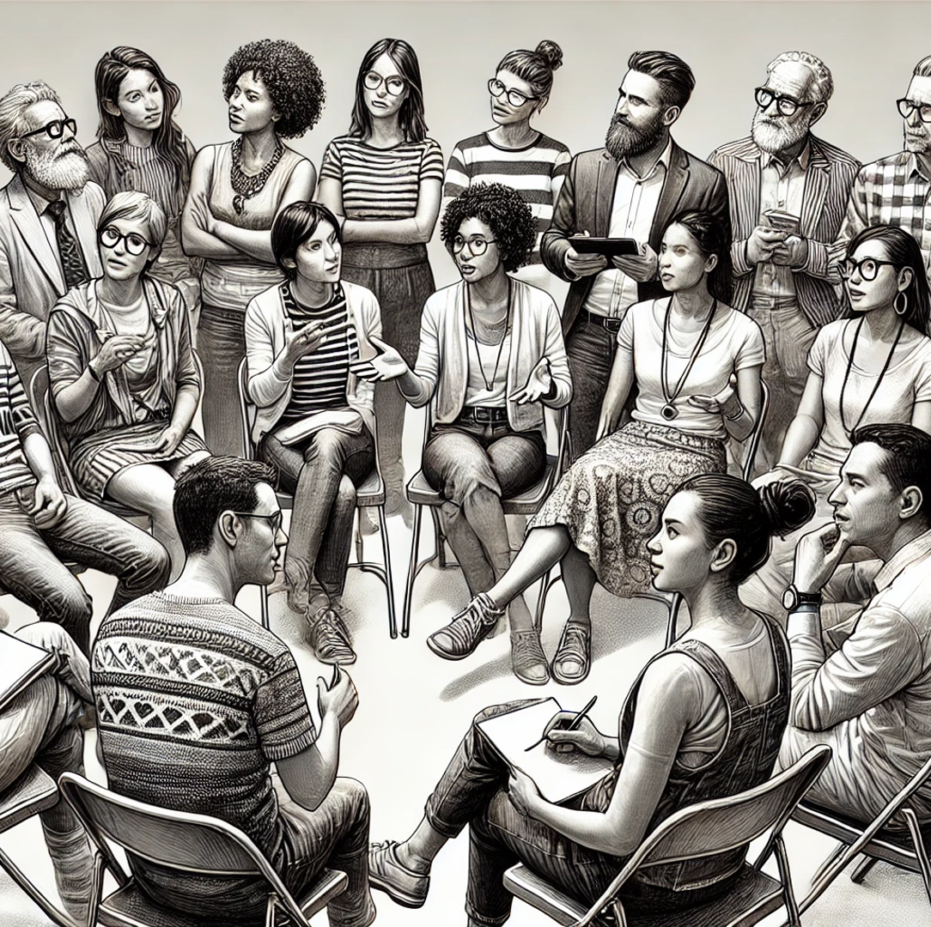
SLAAIT Member Interviews
What We Learned

Slide 4
How State Libraries See AI’s Impact: Trends
AI in the Community | AI in the Library Workplace | Workplace Restrictions
Digital Literacy: Increasing Inclusion and Closing Gaps | Need for Training and Education | Policy and Governance
Misinformation and Disinformation | Elements of Job Impact | Ethical Considerations
Tool Accessibility | Tool Accessibility

Slide 5
What SLAAIT Members Want: Summary
Guidelines for adopting AI tools and technology in libraries. Ethical considerations. How is AI is being integrated into database tools? | Updates on AI-related state and federal legislation. Impact on individuals, communities, and libraries. Ethical considerations. | Updates on AI projects across states. How is AI used in libraries and education? What has worked? What hasn’t? The process behind AI-related decisions. In Progress | How can librarians can be more vocal about AI developments and tools in the communities they serve? Examples: structured workshops, seminars, TED-style talks. | Guidance for creating AI training resources. Foundations, advanced.
A list of AI tools and pricing information. Quality and advantages of free vs priced tiers. | How to identify quality AI training. Training offered by for-profit vs. non-profit orgs. | How to use AI to write grants, including for Tribal libraries. | AI resources relevant for small and rural libraries. How are their priorities unique? | How are content producers and creatives using AI? Ethical considerations.

Slide 6
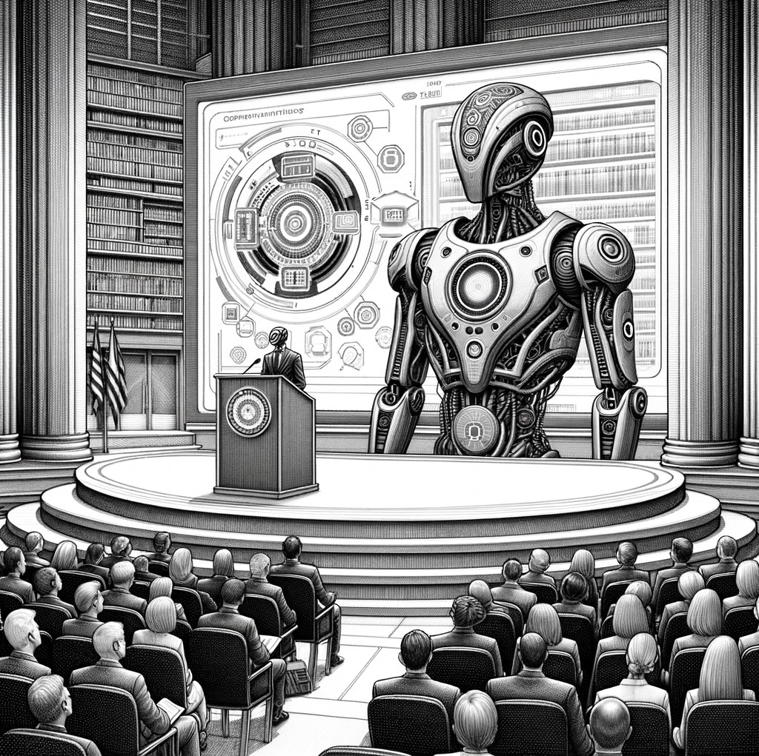
Upcoming Seminars
July & August, so far

Slide 7
Upcoming Seminars: Tuesdays at 2pm CT
June 25: Leila Green Little Discusses AI and Book Bans - RECORDING AVAILABLE
July 16: Megan Hammond - Arizona State Library and AI Training
July 23: Michelle Bradley - State Library of Michigan's AI Discussion Group
July 30: Kieran Hixon - Support for AI in Colorado's Rural Libraries
Aug 6: Dianne Connelly - Data Training for Small Public Libraries
August 13: AI Ambassadors - An Evergreen Learning Opportunity for Libraries
August 20: LibraryLinkNJ AI Ambassadors: Training & Highlights

Slide 8
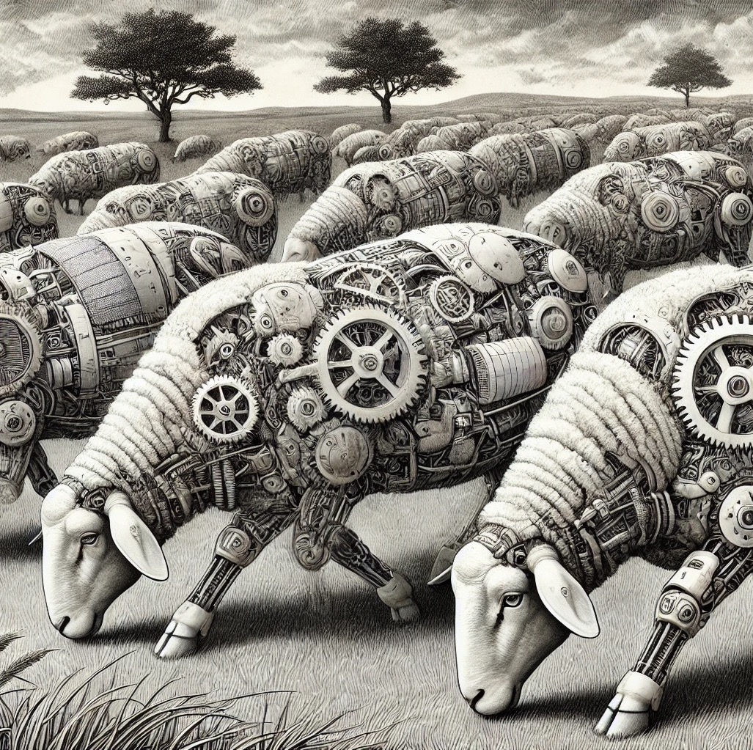
AI Petting Zoo
Virtual Lab & Documentation

Slide 9
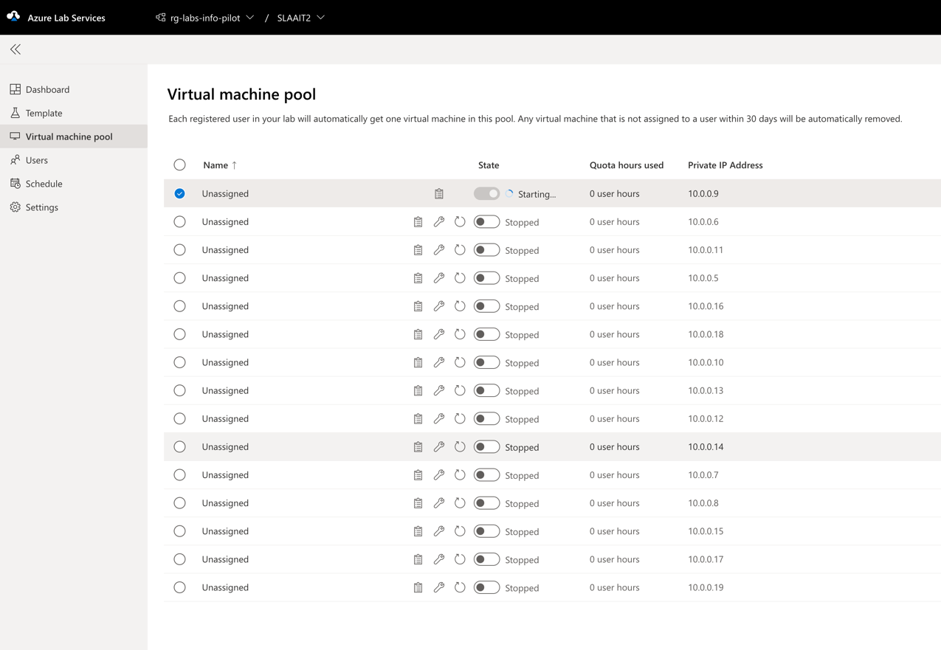
AI Petting Zoo: A Virtual Learning Lab

Slide 10
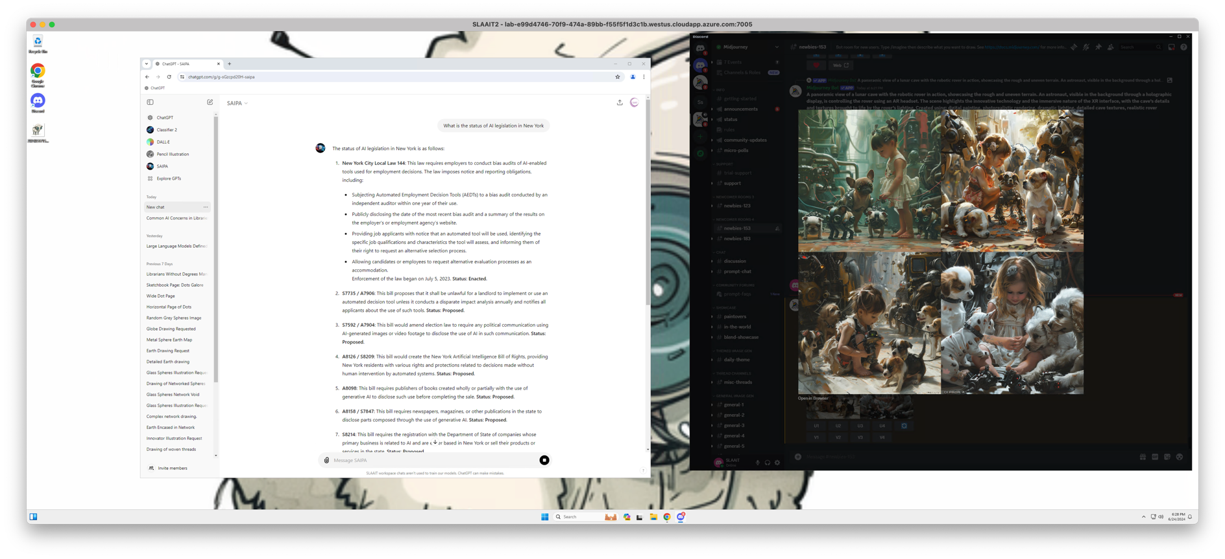
Azure Hosted Services

Slide 11
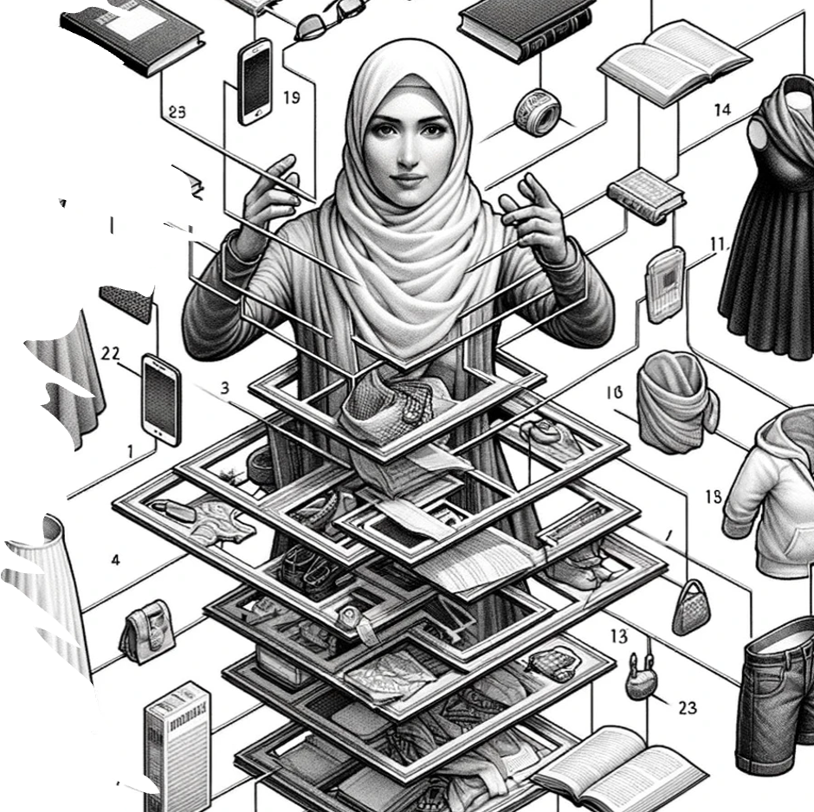
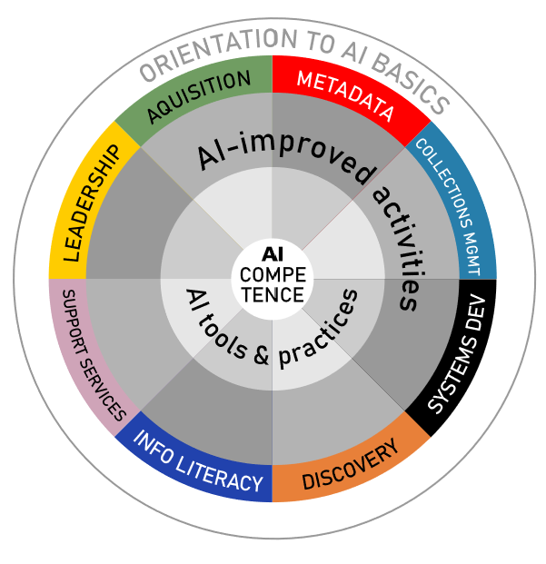
AI Competencies
After reviewing the sources and exploring what resources are available regarding AI competencies for librarians, there is a noticeable lack of literature for public libraries and school libraries. The research is focused more on academic libraries and teachers in K-12 education.
Additionally, many of the competencies recommended encompass not only technical skills, but also soft skills and ethical considerations. A key competency that is missing from the research is skills in selecting, acquiring, and maintaining AI-based software.
What librarians and staff need to know to know

Slide 12
Discussion

