Slide 1



State Libraries and AI Technologies (SLAAIT)
A Project Overview
A CIRCL Work Group

Slide 2

Agenda
Overview of the Project
Dream
  Public Infrastructure
Dread
  Corrosive AI
Destroy
  Washington GPT
Call to Action

Slide 3
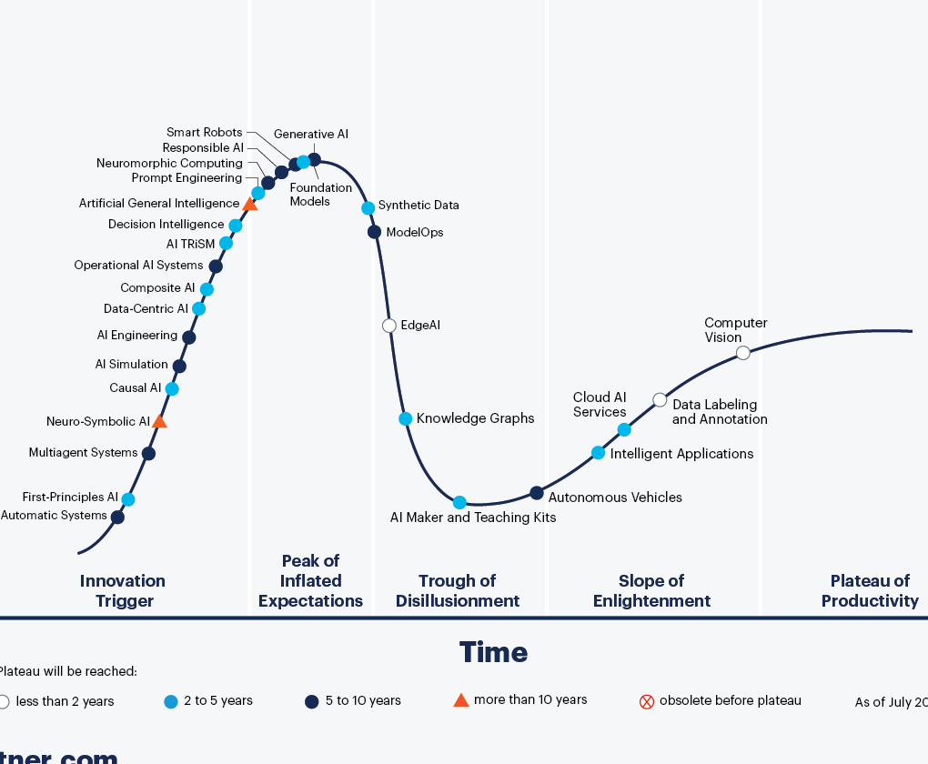
AI is Not Coming…It’s Here
Generative AI and Unbounded AI is at maximum hype
Machine Learning and AI techniques have already replaced deterministic programs: Search, music, fitness, cruise control

Slide 4
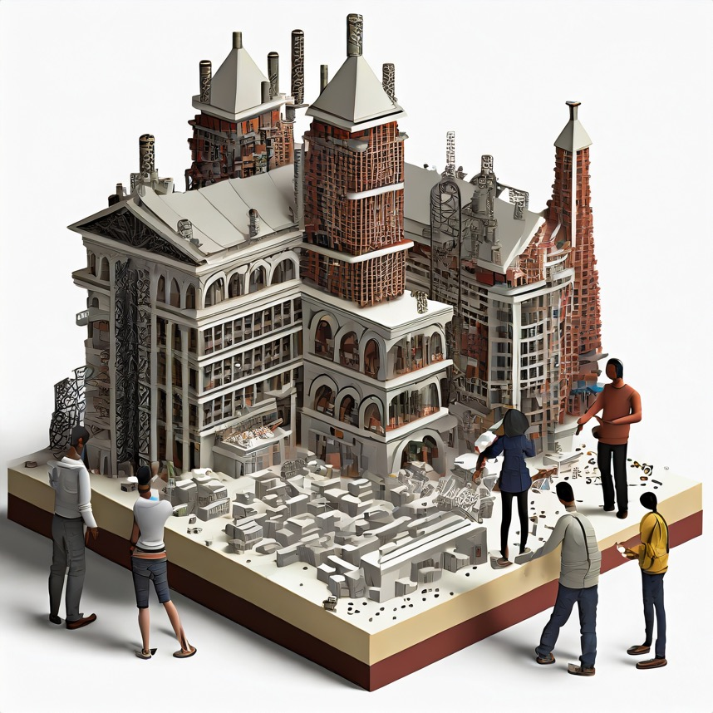
Participating Agencies
Texas State Libraries and Archive Commission
Georgia Public Library Service
State Library of Iowa
New Jersey State Library
Colorado State Library
Washington State Library
Hawaii State Public Library System
Delaware Division of Libraries
New York State Library
State Library of North Carolina
Arizona State Library
Tennessee State Library and Archives
Library of Michigan
State Library of Ohio

Slide 5
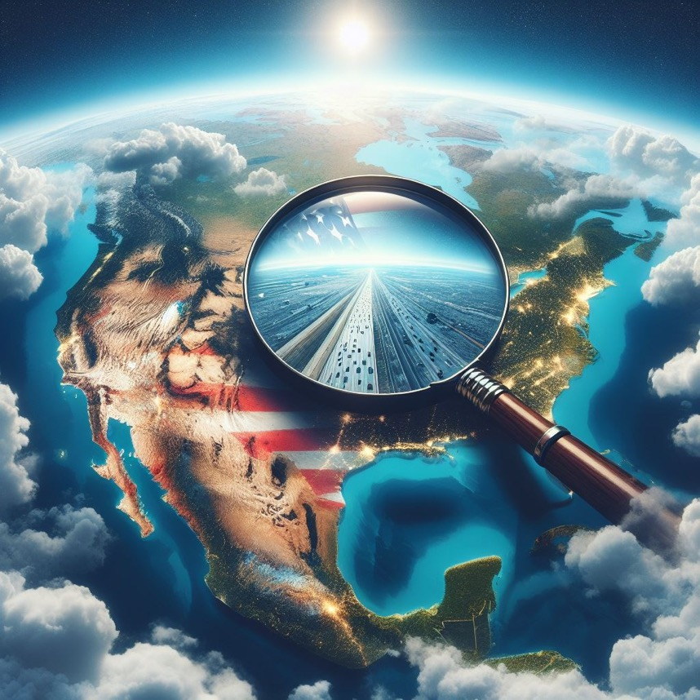
GOAL
To better equip state library agencies to proactively respond to the opportunities and perils in AI.
To provide insight, and participant-specific ideas for projects and applications
To better position state library agencies in growing efforts for AI workforce development, and in their own outreach and support missions.

Slide 6
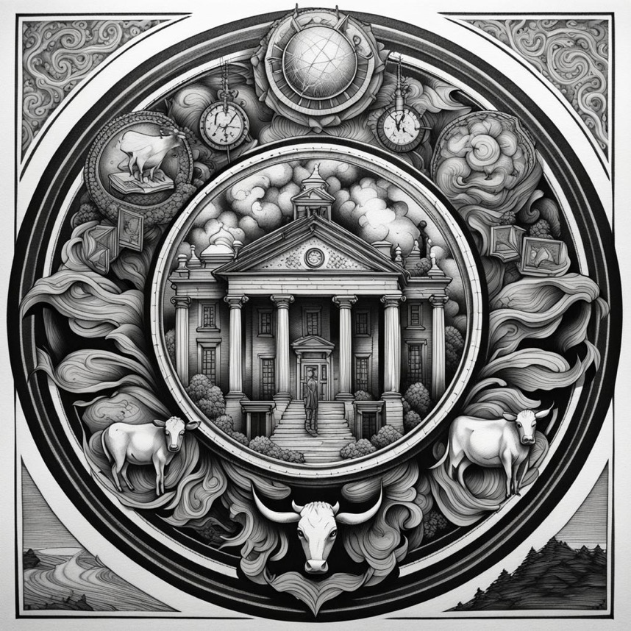
Conversation and Strategy
Tying to Strategic Priorities:
Strategic plans
  LSTA
  SLA
  State
Unique to each participants

Slide 7
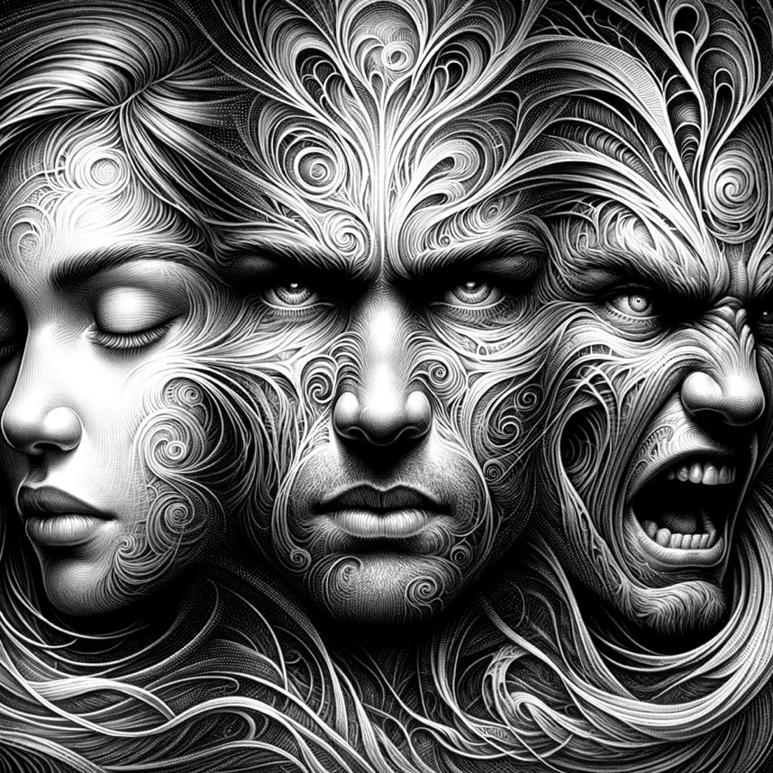
Structure Conversation
DREAM
DREAD
DESTROY
*Stacey A. Aldrich, Hawaii

Slide 8

Dream

Slide 9
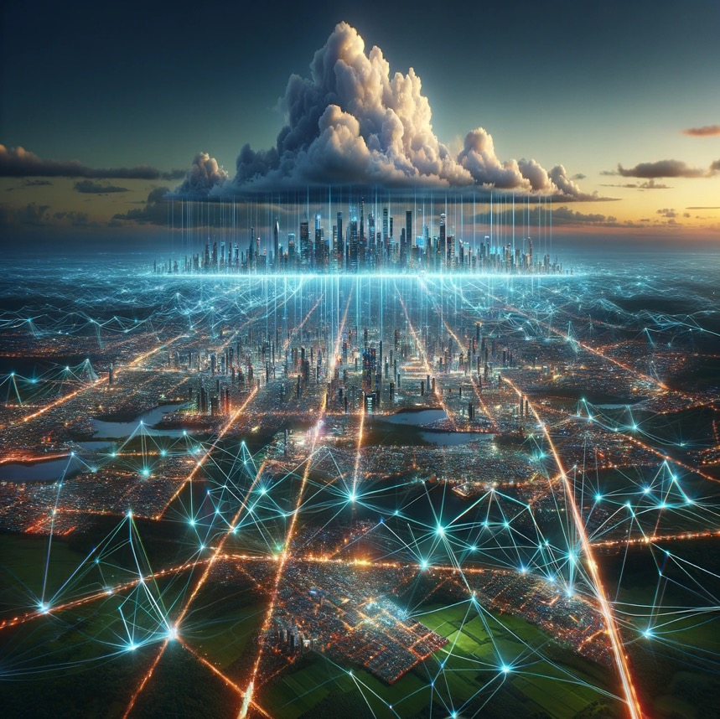
A Public AI Infrastructure
The Big Dream: A distributed and hyperlocal network of human expertise and computing power to support LLM, machine learning capabilities, AI audits, training, and action on disinformation and misinformation
Policy Aspects
Library Aspect

Slide 10
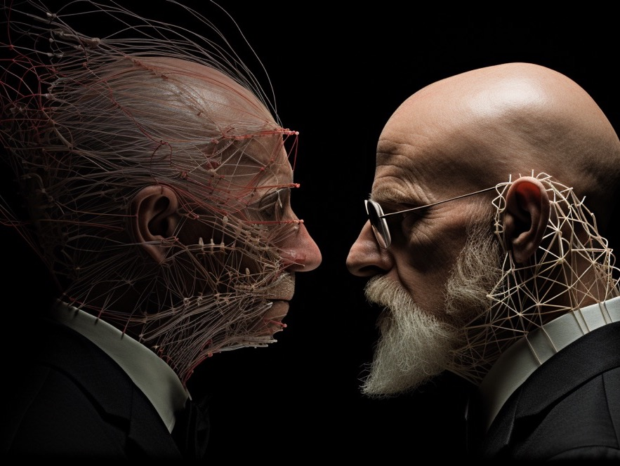
Issues with Corporate AI
A handful of tech giants control the computing resources needed to develop AI models
Result – AI systems designed to serve corporate interests
Heightened inequality, death of privacy, and a threat to democracy

Slide 11
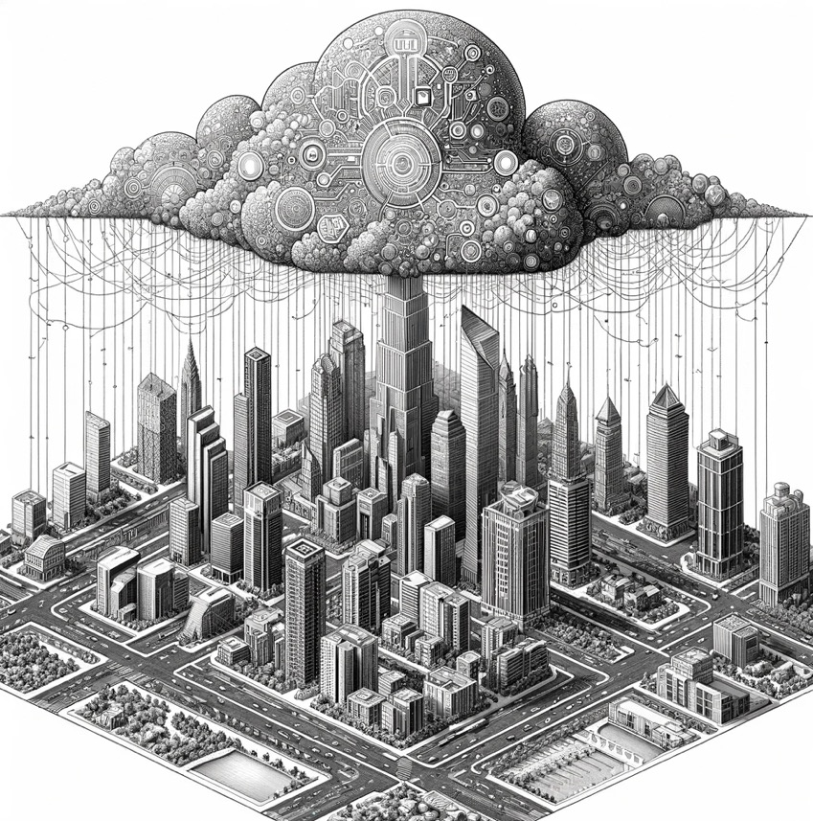
Public AI Infrastructure
Goal – democratize the technology, distribute benefits to everyone
  Inspire innovation
  AI that increases equality
Public Infrastructure
  Universal access to allow everyone to use AI
  Force big tech to compete

Slide 12
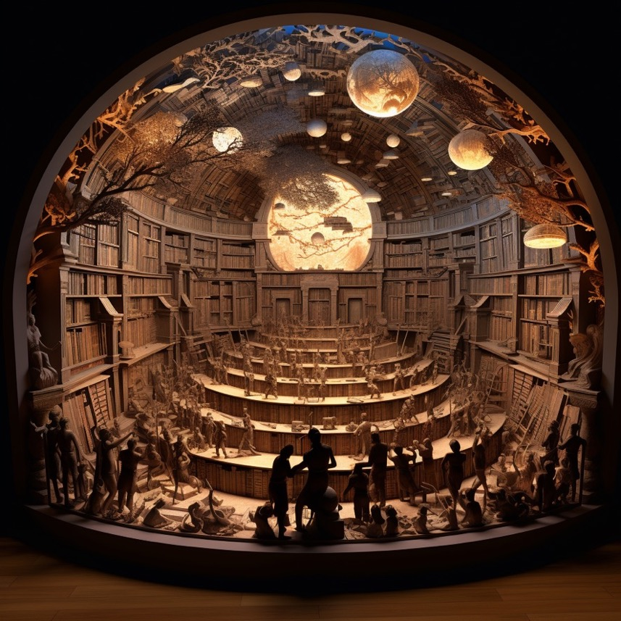
Why Libraries?
Distributed & hyperlocal
Content
Provide access AND training
Long history of technological infrastructure providers

Slide 13
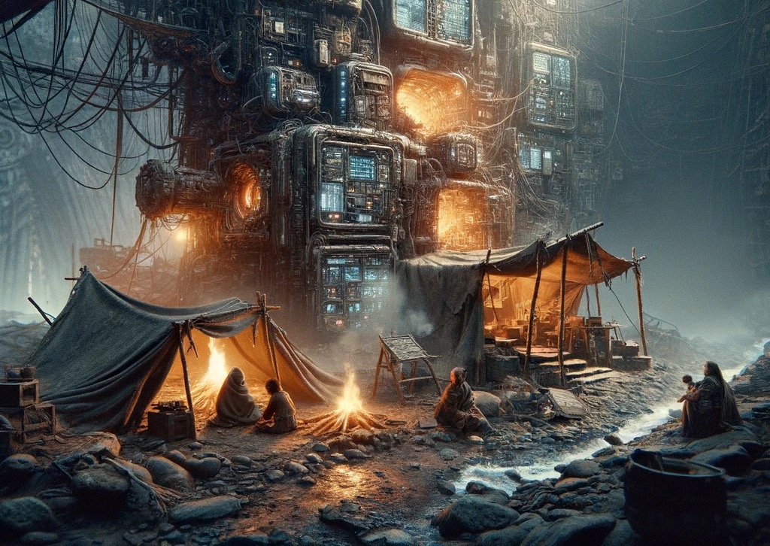
Dread

Slide 14

Corrosive AI
Predictions that generative AI would erode trust
Misuse of generative AI is rapidly corroding political trust
Not the tech itself, but the misuse of it

Slide 15

What Makes AI Corrosive
Rapid Deployment and Development of AI
  AI Arms Race
  We become the AI guinea pigs
Damage to trust in video content
  Doubt in a previously “authentic” representation of the real world
Capability to empower disinformation
  Quick to generate, accessible to all

Slide 16
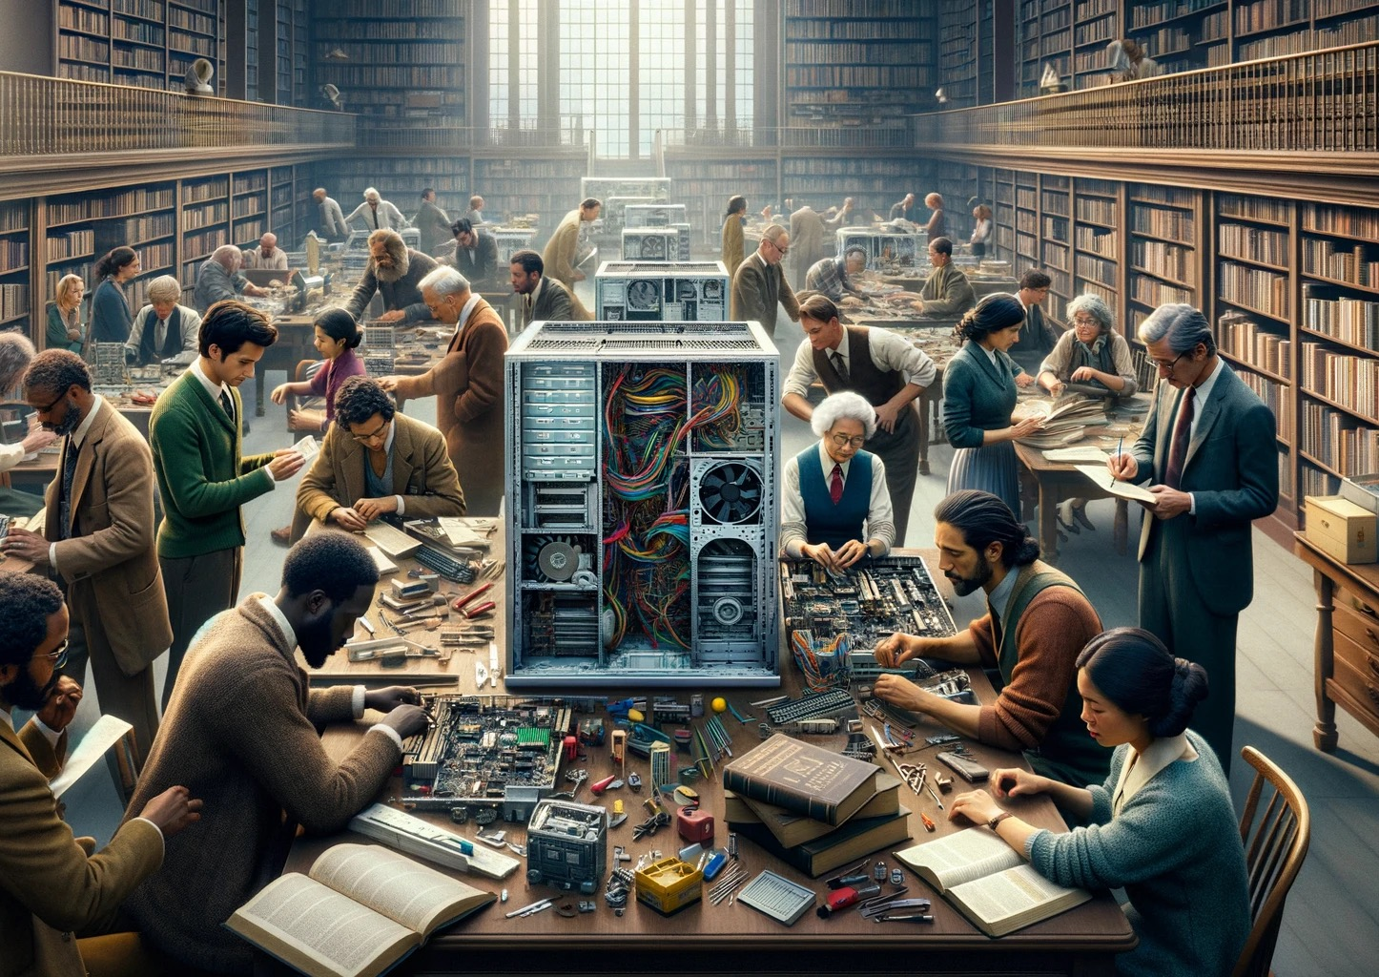
Destroy

Slide 17
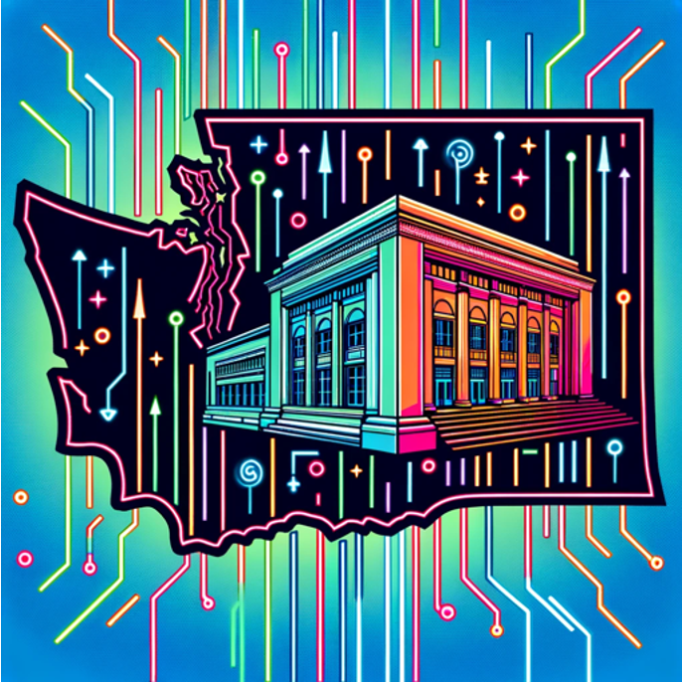
Washington Data Analyzer
“To analyze circulation trends in Washington state public libraries from 2020 to 2023, I reviewed the available data in the provided materials. Here’s a summary of key trends and observations during this period:
1. Shift to Digital Media: There was a significant increase in the circulation of digital media, including e-books and audiobooks, during this period. The surge in digital media usage began in 2020, likely as a response to the COVID-19 pandemic, which led to lockdowns and restricted access to physical library locations. This trend continued to rise even as libraries began to reopen, indicating a lasting shift in user preferences towards digital formats.
2. Gradual Recovery of Physical Circulation: The circulation of physical books and other materials experienced a sharp decline in 2020 due to the pandemic. However, as restrictions eased and libraries adapted with measures like curbside pickup, there was a gradual recovery in physical circulation. By 2023, while physical circulation had not fully returned to pre-pandemic levels, there was a noticeable rebound.
…
These trends suggest a transformation in how users interact with library services, emphasizing the importance of digital media and online access. Libraries may need to continue adapting their strategies to balance between physical and digital services, address the digital divide, and meet the evolving needs of their communities.”
The first one, which took less than a half hour to make (mostly downloading and uploading more than 30 spreadsheets), is called the Washington Public Library Data Analyzer, and it has ingested the Washington Public Library statistics from 2000-2022.

Slide 18

A Call to Action: Unleash the Stories of the Community

Slide 19

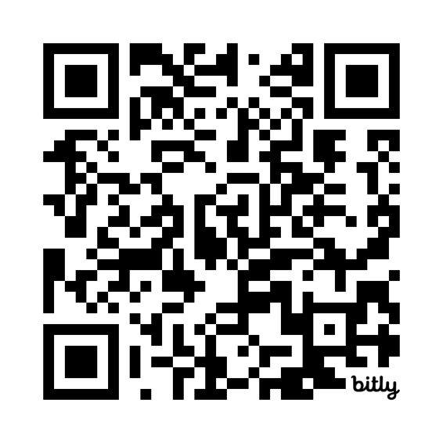

Follow and Join
https://CIRCL.community

